Slide 1


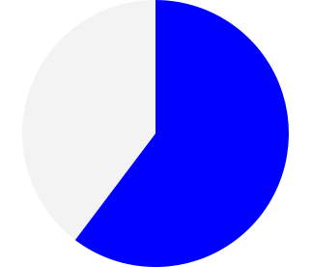
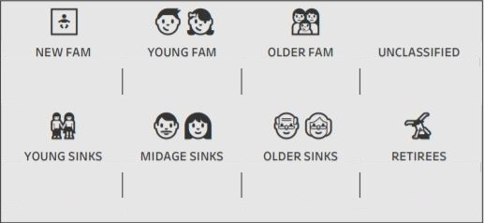
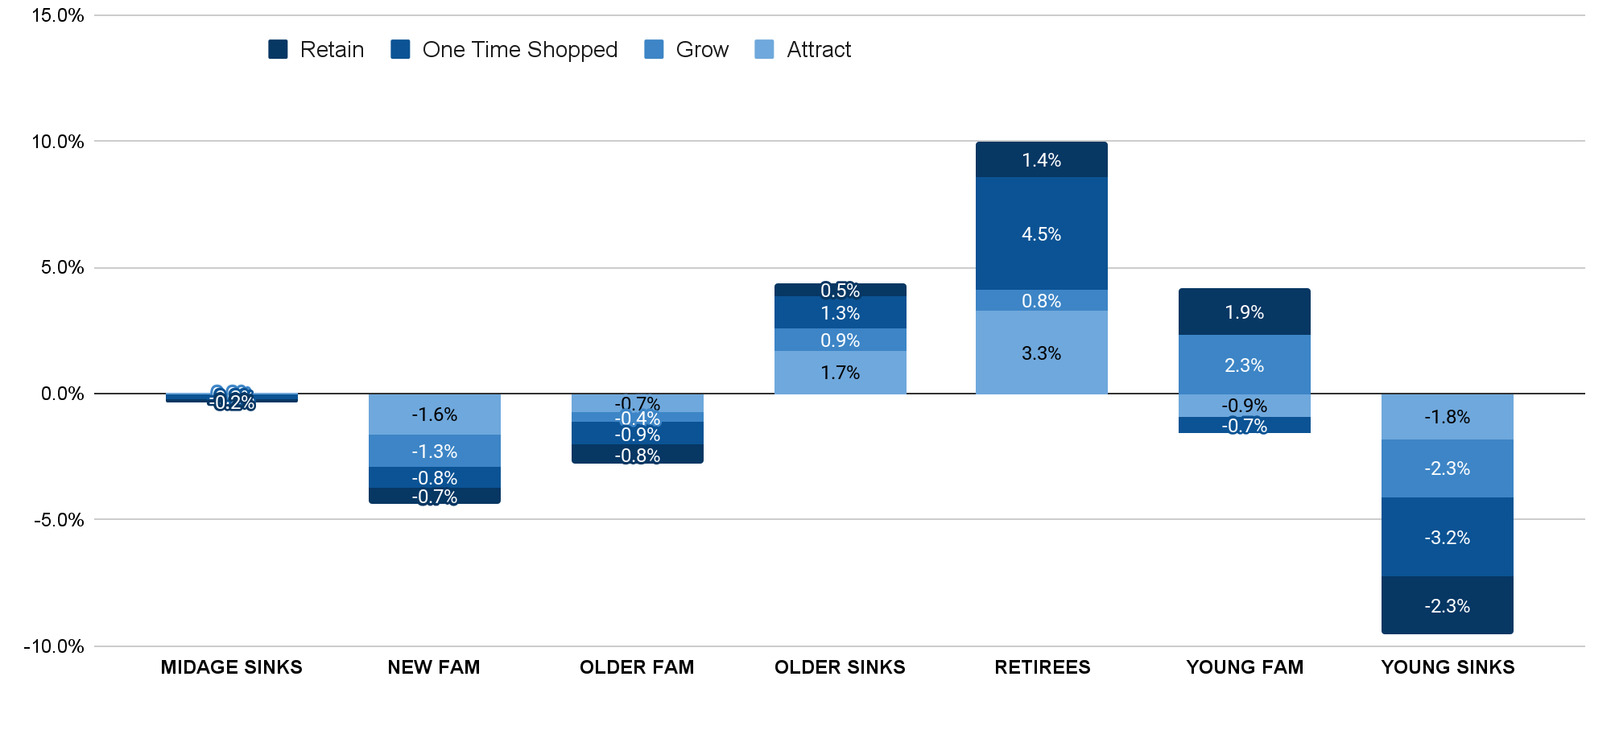

Partner X Customer Performance -
July 2029
Total Sales
Non-Member Sales
Member Sales
■ RETIREES ($2.9m, -5.1% YoY) and YOUNG FAMS ($4m, -13.3% YoY) had the highest growth while NEW FAMS ($1.1m, -27.1% YoY) and YOUNG SINKS ($1.1m, -34% YoY) had the lowest growth.
■ Retain members ($7.2M) had the largest sales growth (1.9% YoY).
■ Monthly Frequency of Retained customer base was 3 shops (0.2% from Last Month).
■ 41% of Partner X baskets were from members cross shopped at Supers as well as Partner X (0% from Last Month).
■ The Scan Rate was 50.5% (+3.1% YoY) and Tag Rate was 57% (+4% YoY).
■ The Average Order Value for Members was $41 (-1% from Last Month).
■ Member $ AOV YOY growth was -5% and Non-Member $ AOV YOY growth was -8%.
-15% vs LY
309.4 M
$20m 20%
$15m -10%
$35.0m
-15 vs LY | -15% vs LY
Value | High / Medium | Low | Lapsed
SOW 55%+ | Retain 72.2 1.9% vs LY | Attract 34.9 -26.6% vs LY
30%-55% | Grow 78.8 -15% vs LY
0% - 30%
1st Time Shoppers | One Time Shopped 10.2 -28.6% vs LY
$1.2m -27.1% | $4m -13.3% | $2.1m -20.3% | $2.8m 99.1%
$1.1m -34% | $1.9m -21.5% | $3.1m -14% | $2.9m -5.1%

